Slide 1
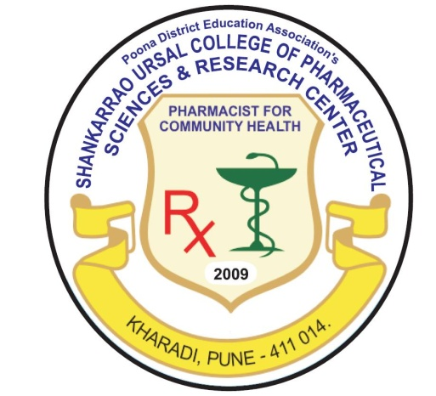
Pune District Education Association’s Shankarrao Ursal College of Pharmaceutical Sciences & Research Centre, Kharadi ,Pune.
RESEARCH AREAS
Enhancement of solubility of poorly soluble aqueous drugs/API’s
Development of novel drug delivery system for antiviral drugs especially for the treatment of AIDS
Design of novel drug delivery system by using natural excipients (Ocimum basilicum)
Formulation development for colitis (Colon cancer)
Formulation development of micro emulsion, transdermal patch
Taste masking of extremely bitter drugs using ion exchange resins
Formulation and development of floating drug delivery system
Prediction of formulation properties (invivo and invitro) by applying QSPR

Slide 2
Pune District Education Association’s Shankarrao Ursal College of Pharmaceutical Sciences & Research Centre, Kharadi ,Pune.
QSAR studies
Development and validation of stability indicating assay method for determination of API’s /
drugs in pharmaceutical dosage forms by RP-HPLC
Physicochemical characterization of monoclonal antibodies using size exclusion chromatography,
Lowry’s method, SDS (Sodium Dedocyl Sulphate) polyacrylamide gel electrophoresis, UV
spectrophotometry.
Analytical method development for determination of API’s/drugs in pharmaceutical dosage forms
and validation using UPLC/ HPLC/ HPTLC
Development and validation of RP-HPLC method for estimation of residual Glycine in pneumococcal
conjugate vaccine
Development and validation of biochemical assay for quality control of vaccines

